Slide 1

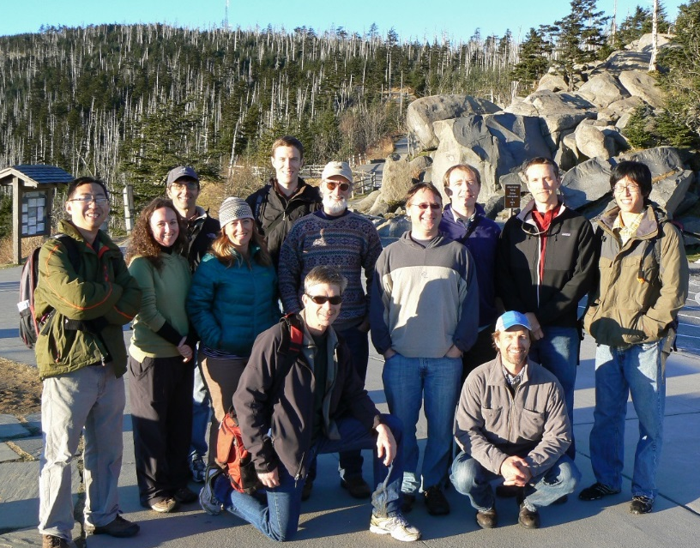




Landscape Climate Change Vulnerability Project (LCC-VP)
Montana State University:
Andy Hansen, Nate Piekielek, Tony Chang, Linda Phillips
NPS / Great Northern LCC:
Tom Olliff
NPS I&M Program:
Bill Monihan and John Gross
CSU Monterey Bay / NASA Ames:
Forrest Melton, Weile Wang
Conservation Science Partners:
Dave Theobald
Woods Hole Research Center:
Scott Goetz, Patrick Jantz, Tina Cormier, Scott Zolkos
Clingman’s Dome, Great Smoky Mountain NP
NASA Applied Sciences Program
(NNH10ZDA001N - BIOCLIM)
NPS I&M Program
Notes:
1

Slide 2
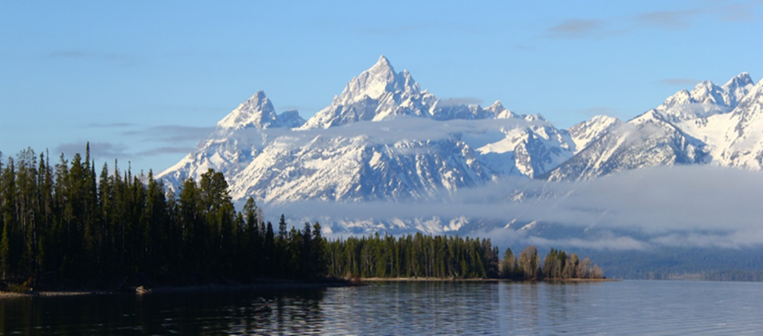
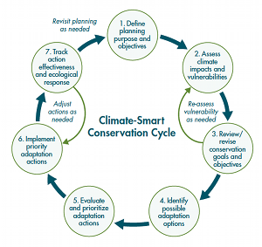
Sustaining Wildland Ecosystems
Wildland ecosystems
Central to the global conservation strategy
Are attracting people and undergoing high rates of land use and climate change
Goal:
Link science and management to understand human-caused change in wildlands and to better inform decision making.
Notes:
2

Slide 3
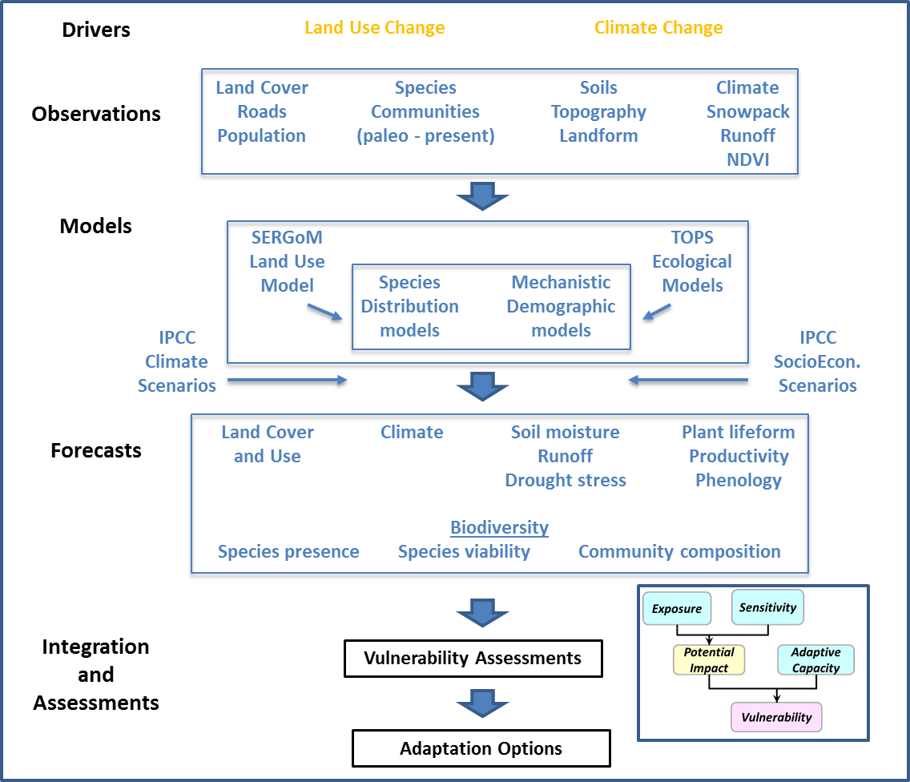
Scientific Assessment Framework

Slide 4
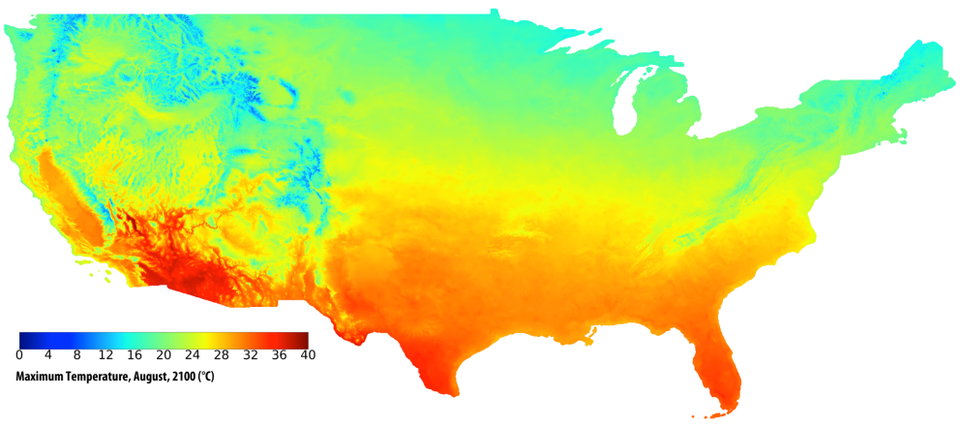
NEX-DCP30: NASA Earth Exchange Downscaled
Climate Projections
LCCVP
Forrest Melton
NASA AMES
GCM Resolution: ~1 degree
30 arc-seconds / 800m / ~0.5 miles
CMIP5 archive downscaled using the Bias Correction and Spatial Disaggregation (BCSD) approach (Wood et al., 2002) and PRISM data (Daly et al., 1997)
Temperature and precipitation scenarios from 1950-2100
34 coupled General Circulation Models (global climate models)
4 Representative Concentration Pathways (RCPs)
  17 TB of data
https://portal.nccs.nasa.gov/portal_home/published/NEX.html
Thrasher et al., 2013, Eos, Transactions AGU, vol 94(37):321–323
Notes:
Coupled Modeling Intercomparison Project Phase 5

Slide 5

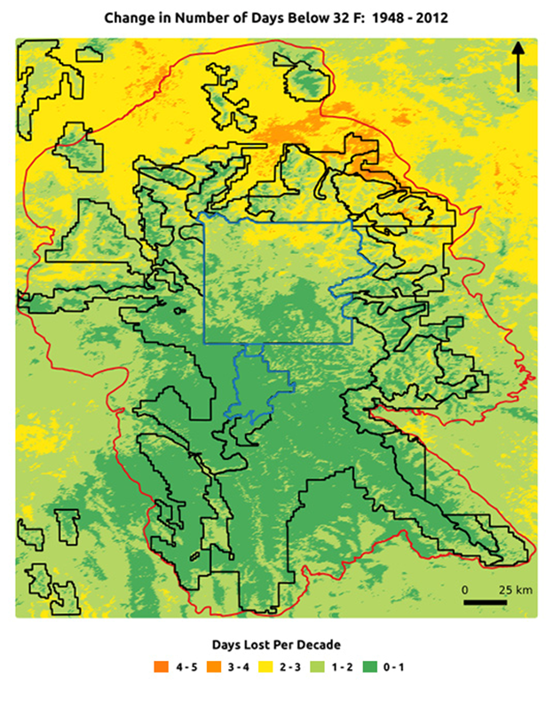
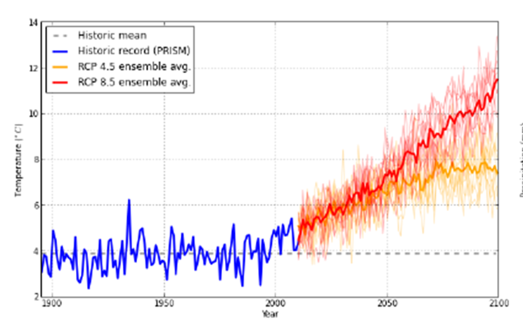
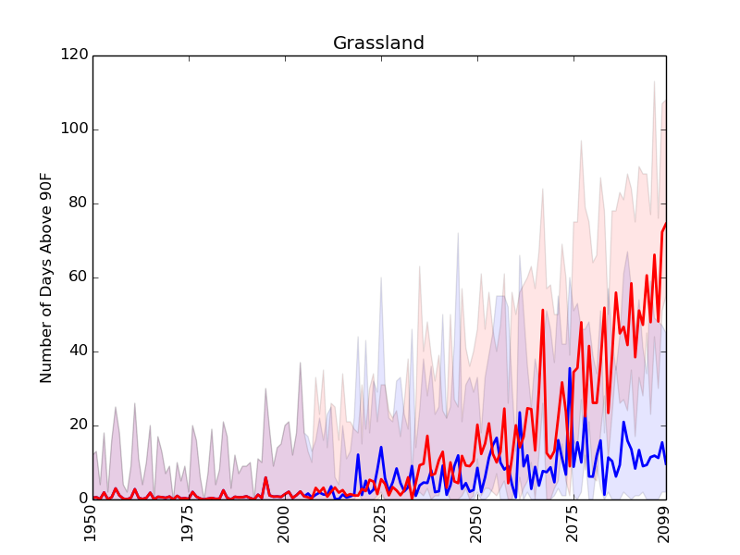
Climate Analyses
Change in Days < 32⁰ F
Traditional Summaries
e.g. Mean, Min., Max Temp.
Ecologically Relevant Summaries
Aridity Index
Days above or below threshold warm or cold temperatures
Habitat specific summaries
Mean Annual Temperature
Days > 90 32⁰ F for Grasslands

Slide 6
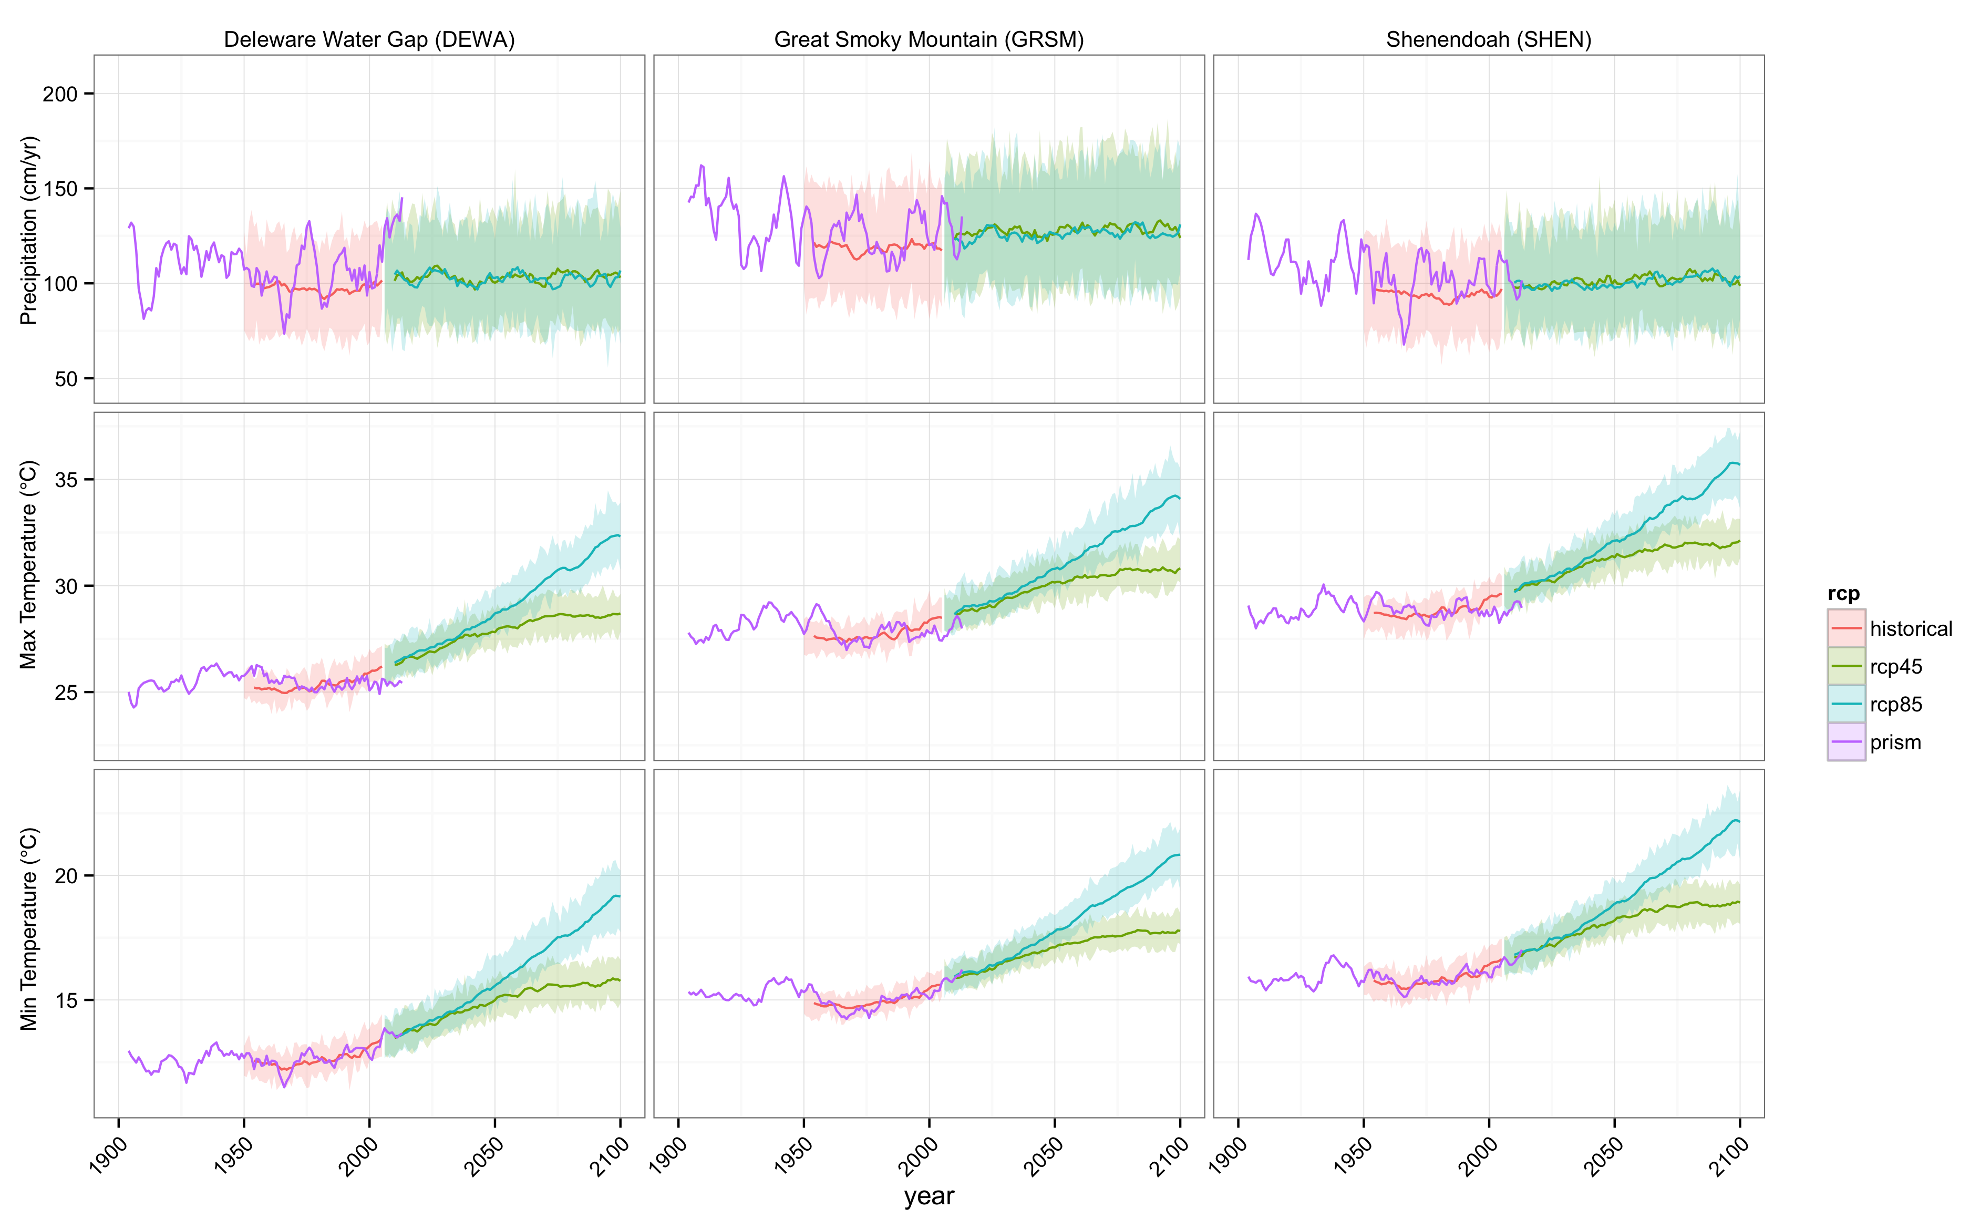
LCCVP
John Gross
NPS
Tony Chang
MSU
Patrick Jantz
WHRC
Climate Analyses
Northern Rockies
1900-2014
  Temperature increase of 1⁰C
  Increased aridity since 1980
  Reduced extreme cold
  Runoff 2-3 week earlier
  Reduced snowpack
  Snow-free days increased ca 14 days
2014-2100
  Temperature increase 3-7⁰C
  Increased ppt
  Increased aridity
  Decreased snowpack and runoff
Appalachians
1900-2014
No trends in average temp and ppt Decrease in days below 0⁰C
2014-2100
  Temperature increase 3-6⁰C
  Days below 0⁰C decrease by 25 - 50%

Slide 7
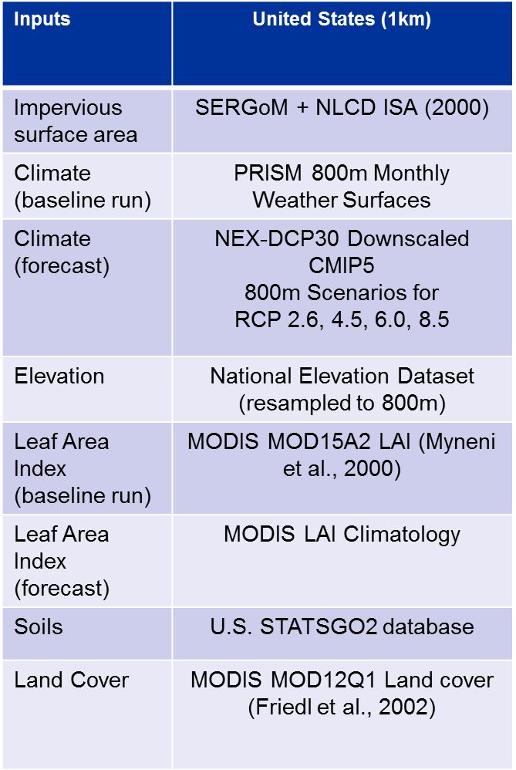
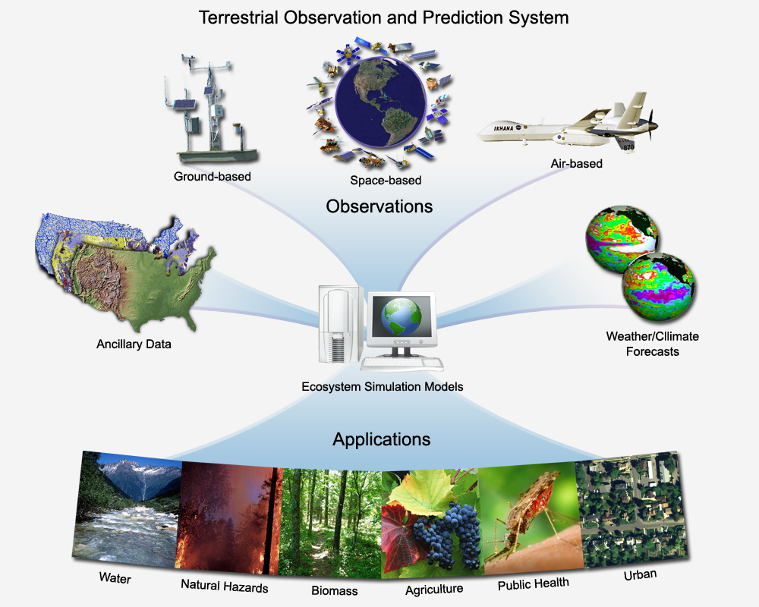
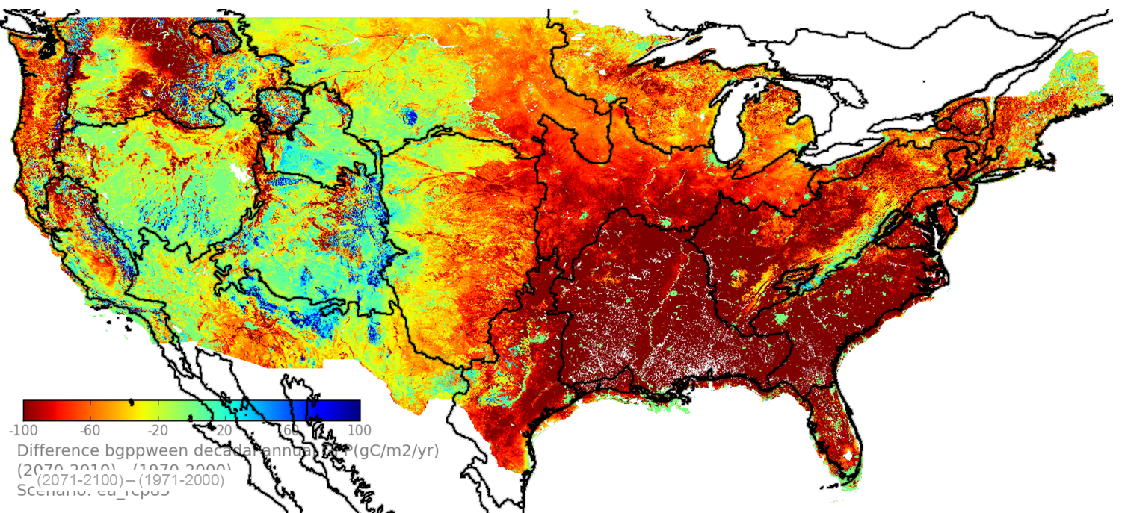
Ecosystem Processes
LCCVP
Forrest Melton
NASA AMES
Nemani et al., 2009
Gross Primary Productivity
RCP 8.5 EA, AVG(2071-2100) – AVG(1971-2000)
Change in GPP (gC/m^2/yr)
(2071-2100) – (1971-2000)
RCP 8.5, Ensemble Avg.

Slide 8
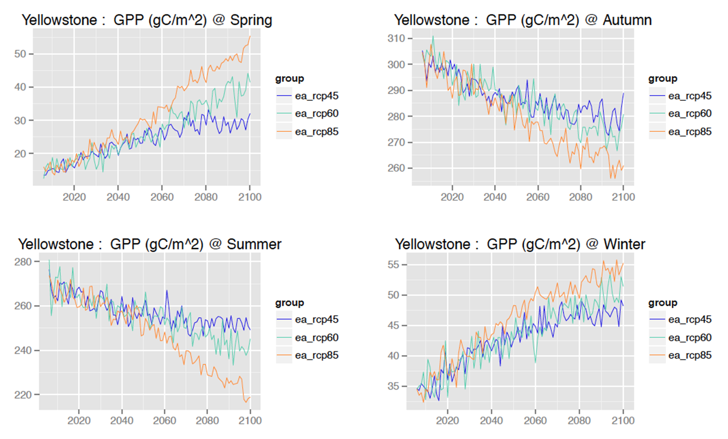
Ecosystem Processes
LCCVP
Forrest Melton
NASA AMES
CMIP5, 8 GCM ensemble average, 800 m
Gross Primary Productivity

Slide 9
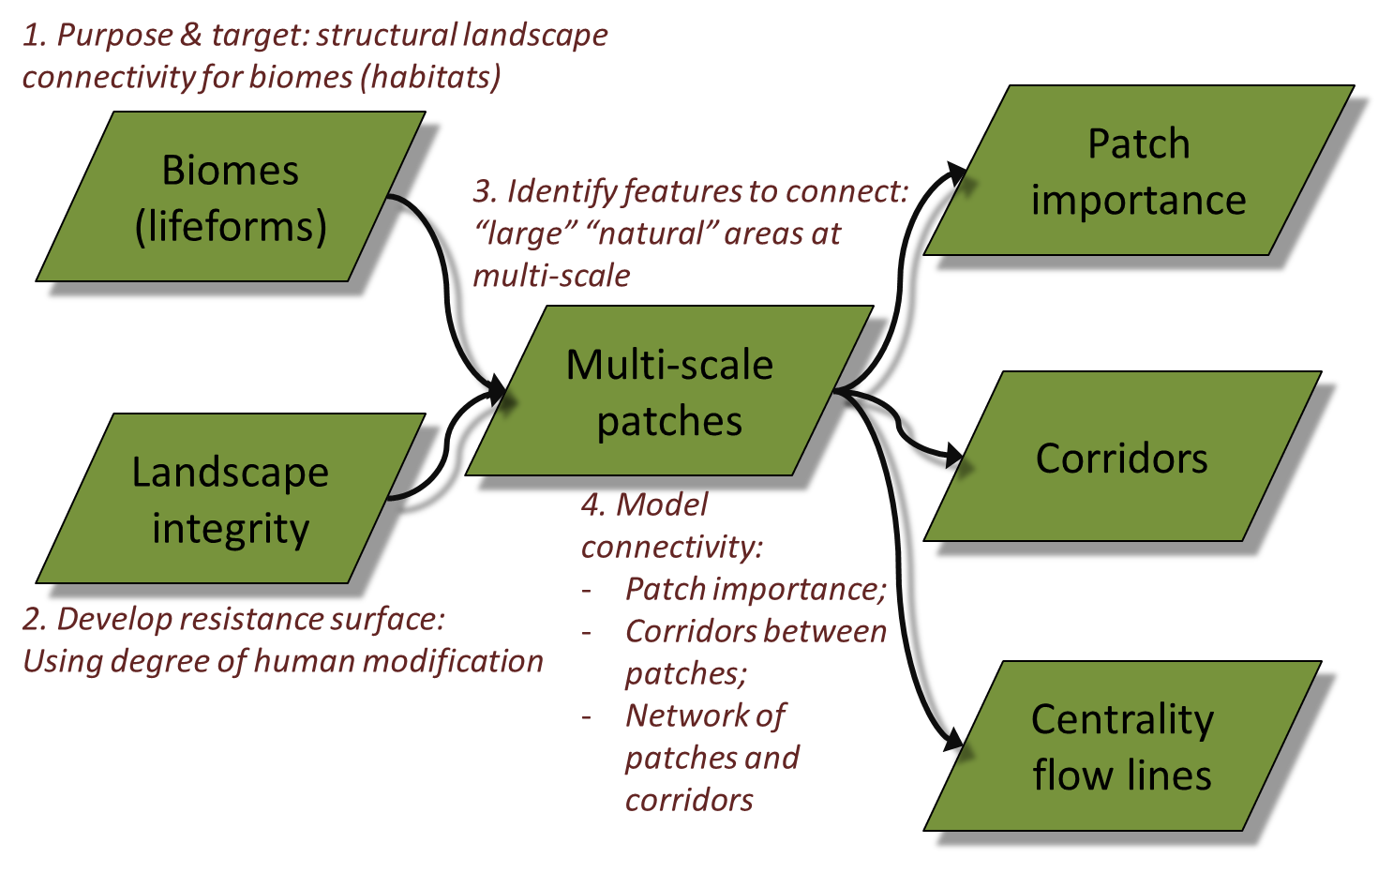
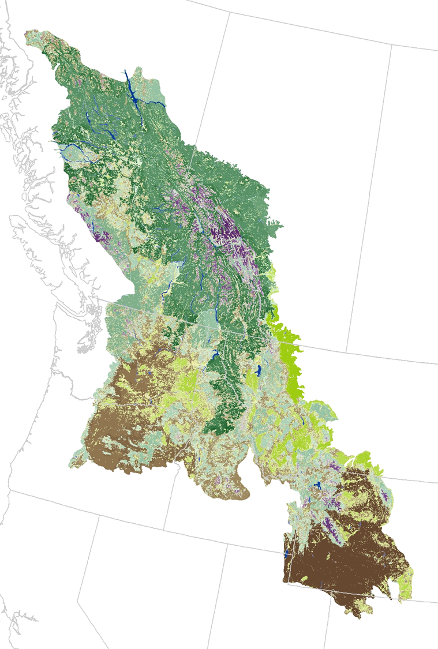
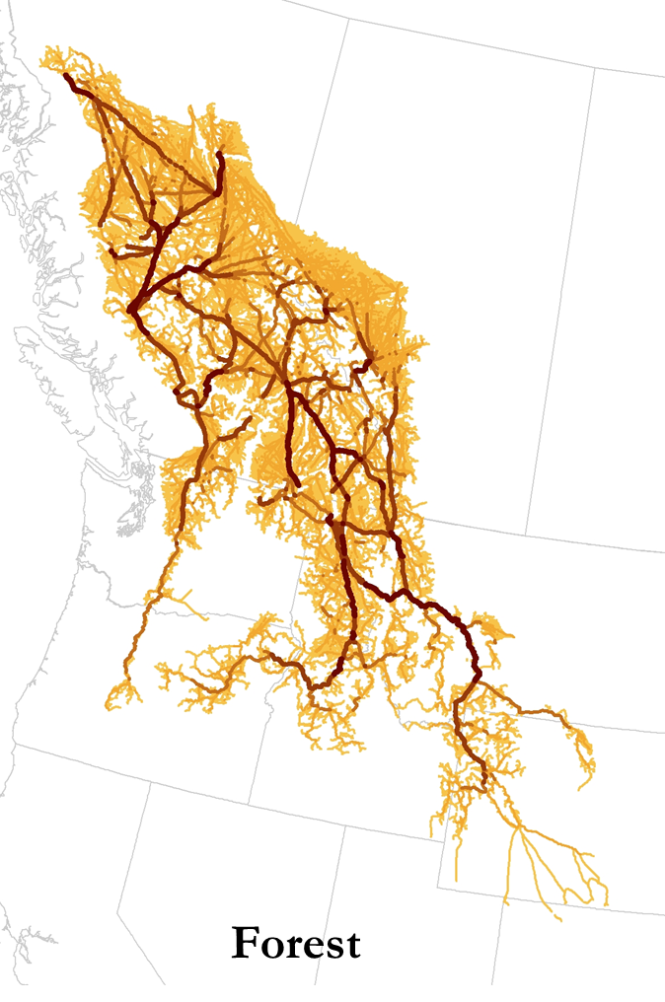
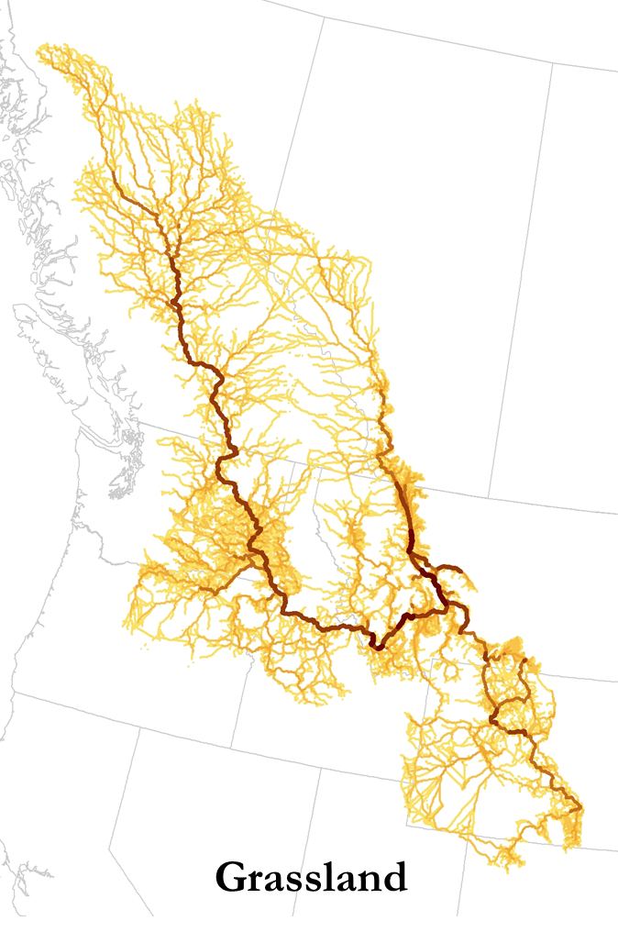
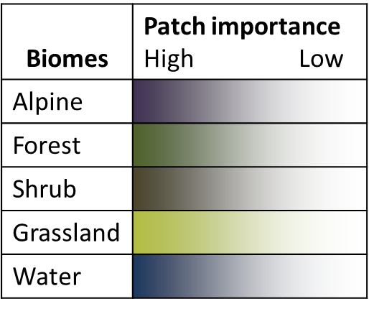
Landscape Permeability by Biome Type
LCCVP
Dave Theobald
CSP
Human Modification
Centrality

Slide 10
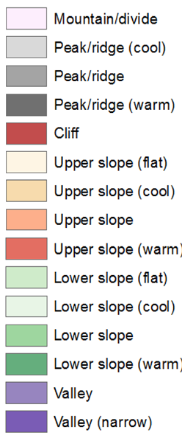
Biome Vulnerability
LCCVP
Dave Theobald
CSP
Biome Vulnerability (f)
Exposure:
Temp
increase
Climate velocity
p biome shift
Adaptive
Capacity:
Land facet heterogeneity
Landscape integrity
Temp Increase Climate Velocity P Biome Shift
Exposure is high:
  up to 5.5C warming,
  climate velocity rates up to 5 kilometers per year,
  nearly 25% of habitats shifting to a different type.
Alpine areas – over 80% will face climate conditions conducive to conversion to forested vegetation.
Adaptive capacity - high because landscapes are relatively intact and there is great physiographic diversity

Slide 11
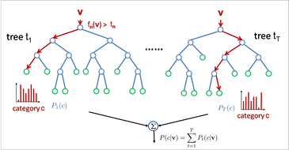
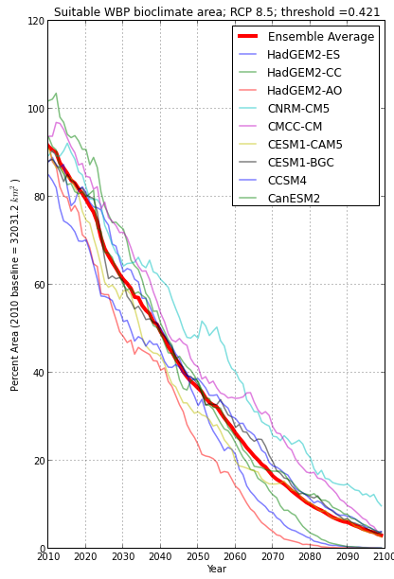
Habitat Suitability Modeling
Methods
Chang et al. 2014; Jantz et al in review: Piekielek et al. in review
Response Data
  2,569 data points from FIA, GYCC, WLIS, GYRN I&M
Predictor Data
PRISM climate (19 variables)
Monthly water balance using Thornthwaite equation (10 variables)
Parent material, topography (10 variables), solar radiation
Species
  12-40 individual species
Analyses
NC CSC Software for Assisted Habitat Modeling (SAHM) VisTrails package
Boosted Regression Trees, Logistic Regression, Multivariate Adaptive Regression Splines, and Random Forest
Model validation based on ROC for withheld data
GCMs
Best 9 CMIP5 GCMs
Random Forests
WBP Suitability under 9 GCMs

Slide 12
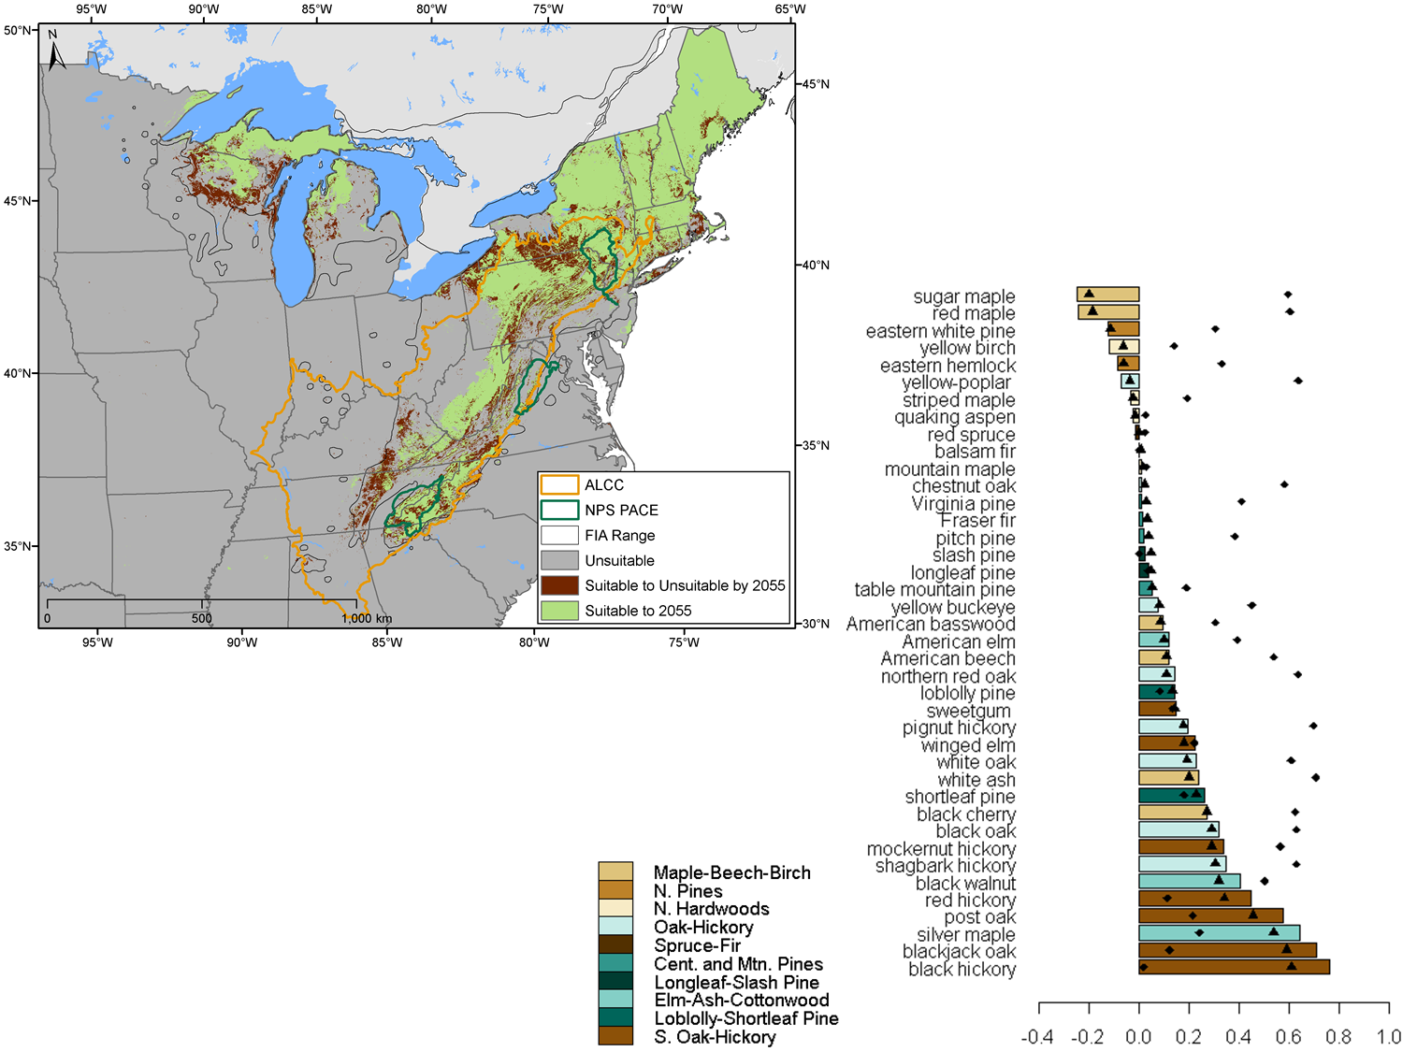

LCCVP
Scott Goetz
Patrick Jantz
WHRC
Vegetation Appalachian LCC
Eastern Hemlock Suitability
Net Change in Suitability
Currently suitable

Slide 13
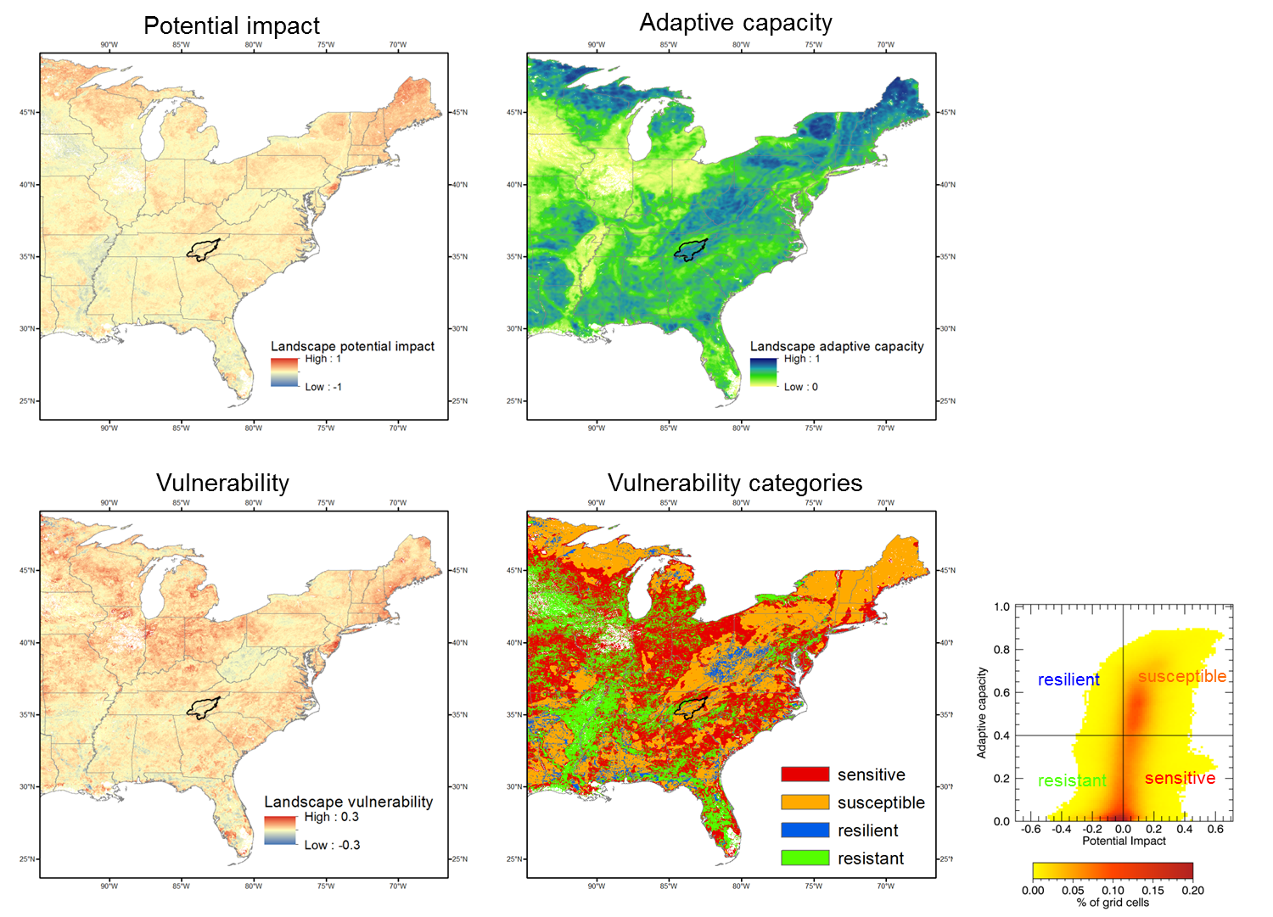
LCCVP
Scott Goetz
Patrick Jantz
WHRC
Vegetation: Appalachian LCC
Integration of 40 tree species
Adaptation Capacity
Historic basal area
Dispersal ability
Forest fragmentation

Slide 14
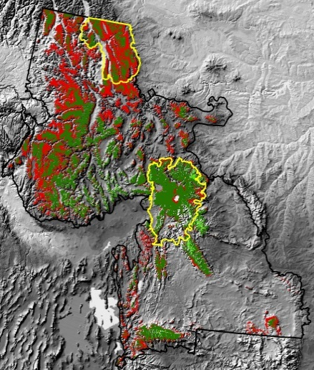
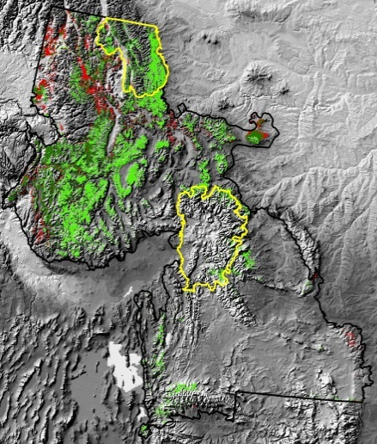
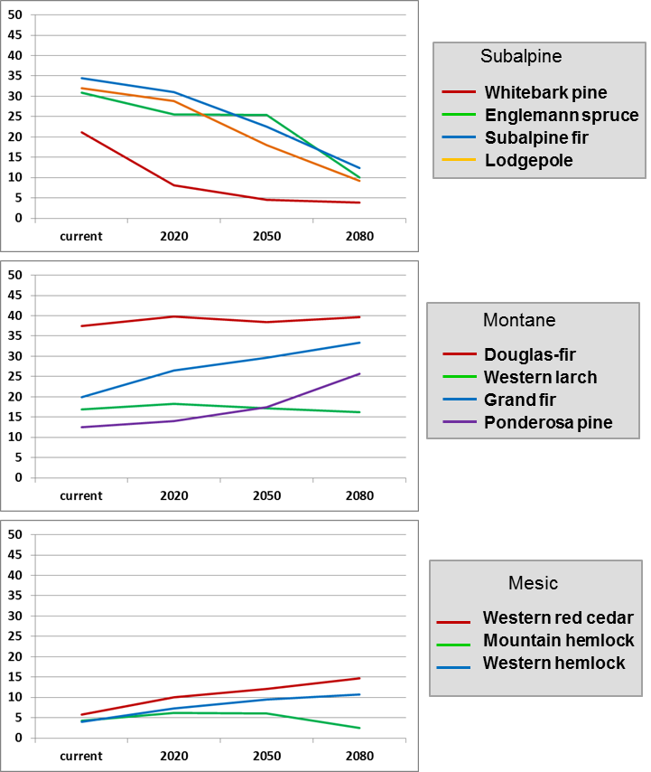
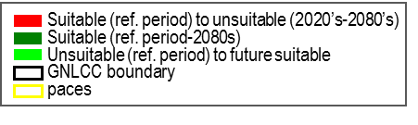
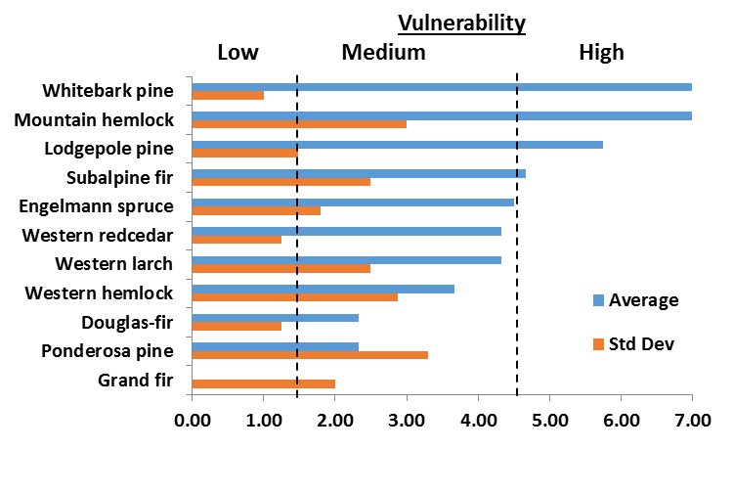
LCCVP
Andy Hansen
Montana State Univ
Vegetation: Northern Rockies
Subalpine fir
Ponderosa pine
Consensus of Four Published Studies: A2 Scenario

Slide 15
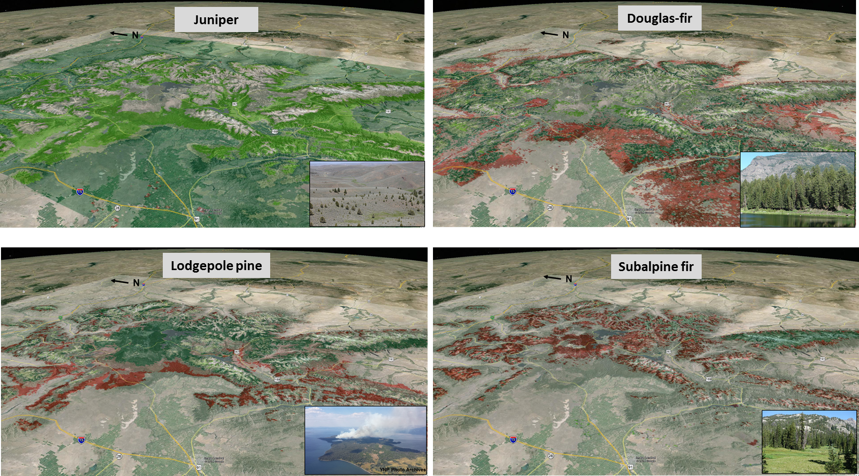
LCCVP
Nate Piekielek et al.
Penn State Univ
Greater Yellowstone
2010 – 2100, RCP 8.5 scenario
Suitable to Suitable
Suitable to Unsuitable
Unsuitable to suitable

Slide 16
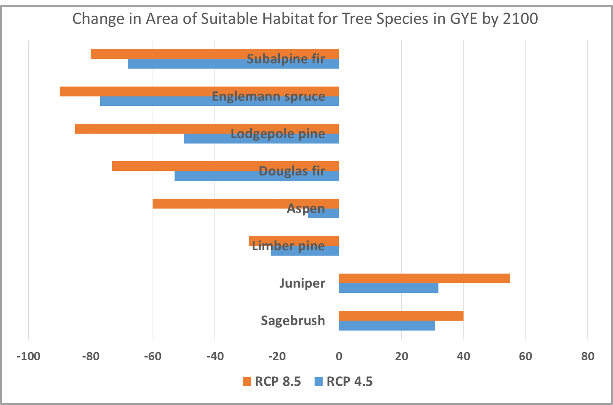
LCCVP
Nate Piekielek et al.
Penn State Univ
Greater Yellowstone
2010 – 2100, RCP 8.5 scenario
Suitable to Suitable
Suitable to Unsuitable
Unsuitable to suitable

Slide 17
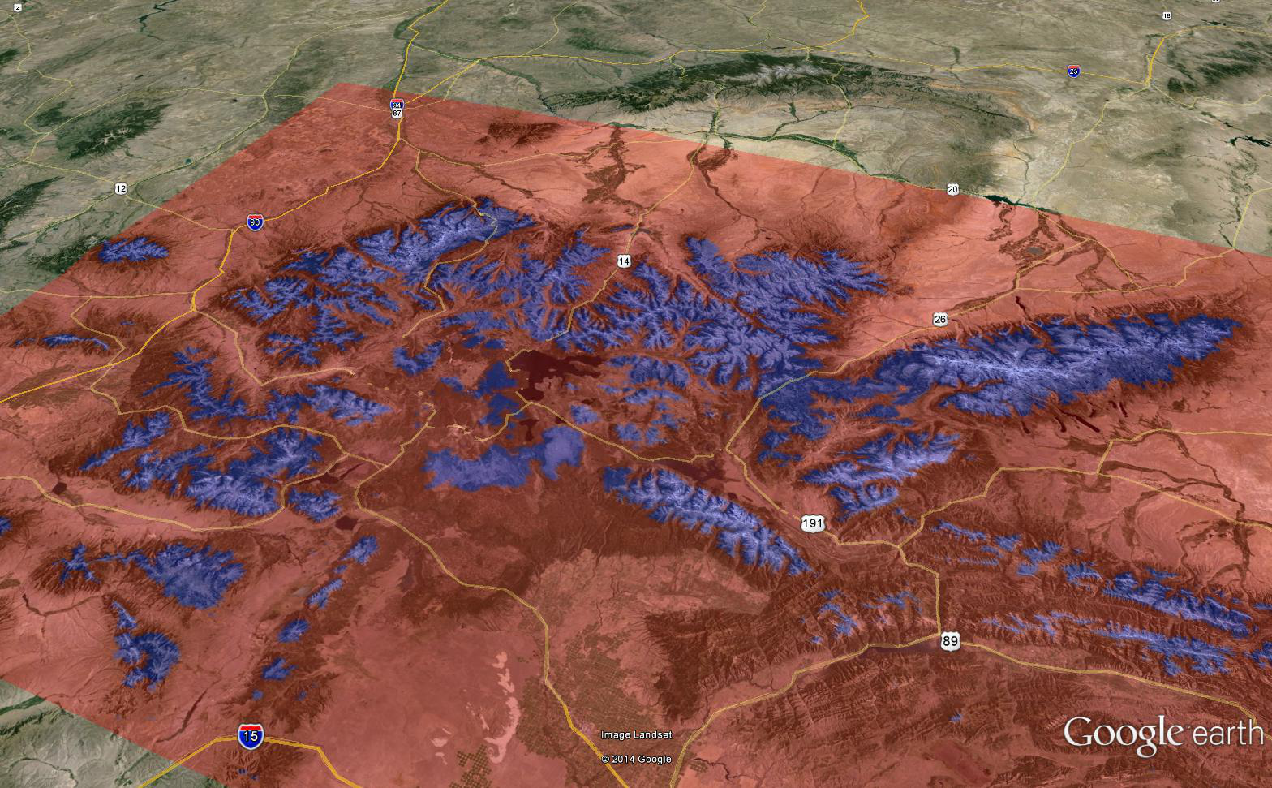
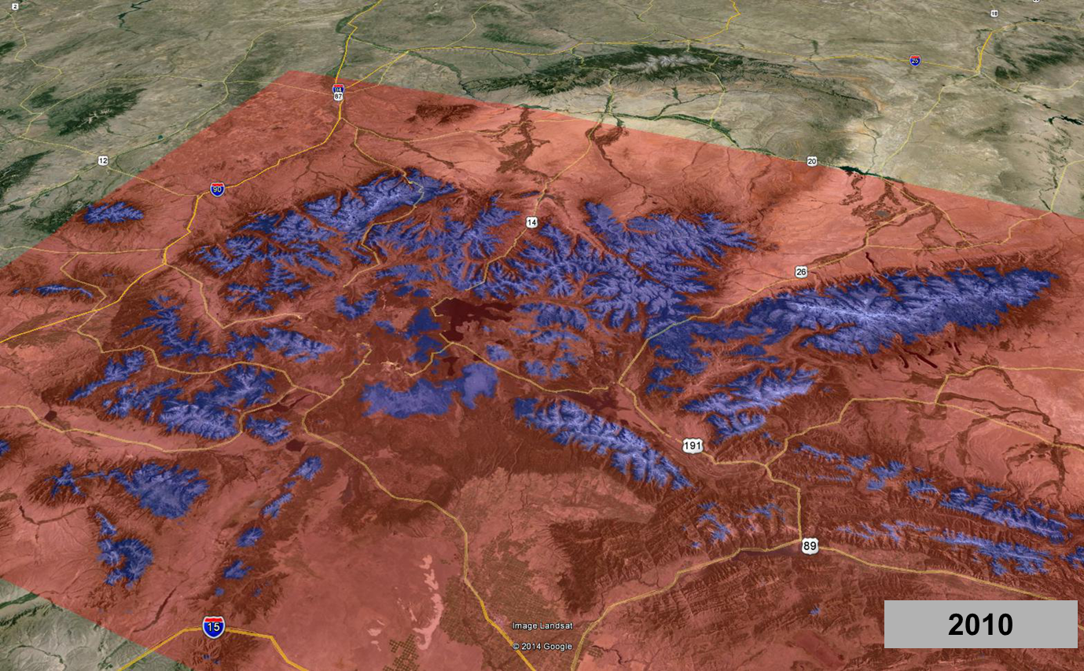
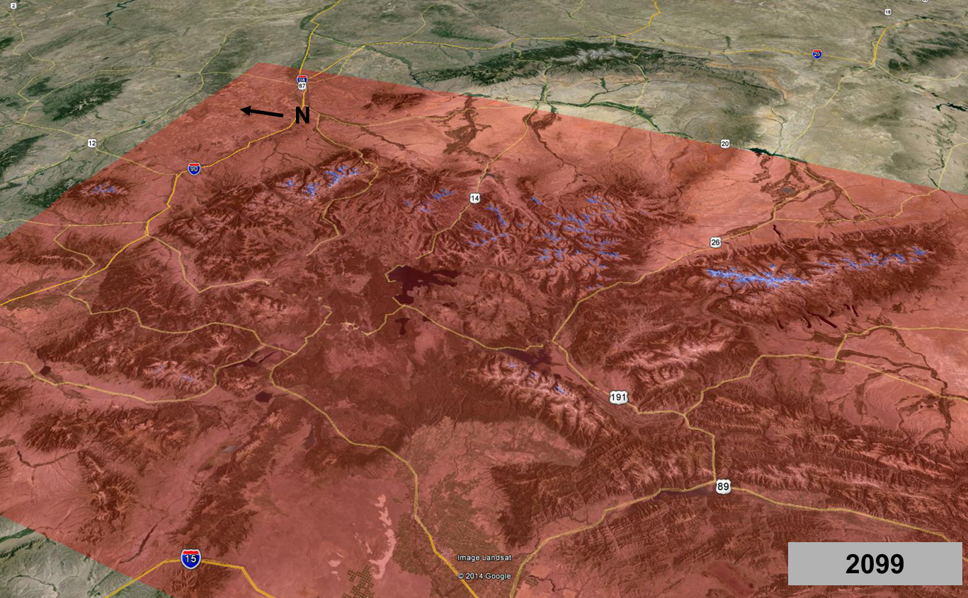
RCP 8.5 scenario
Greater Yellowstone
Whitebark Pine
Prob. Presence > 0.42
% 1950-80 Suitable Habitat
2010 2099
RCP 4.5 91.3 17.8
RCP 8.5 91.3 3.0

Slide 18
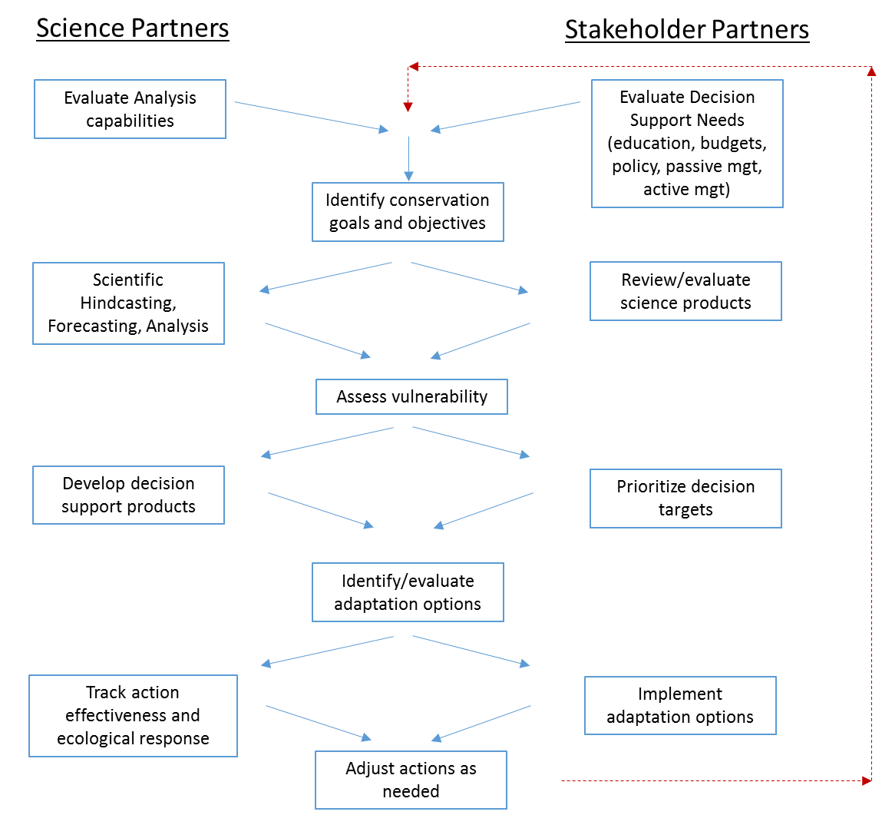
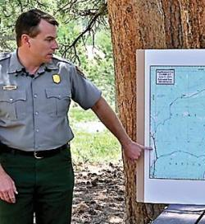
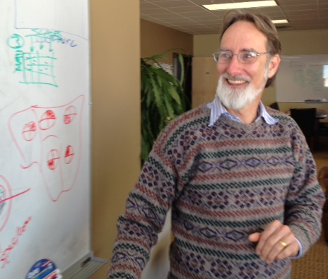
Climate Adaptation: Collaborative Approach
John Gross, NPS Climate Scientist
Ben Bobowski, Chief of Resources, Rocky Mountain National Park

Slide 19
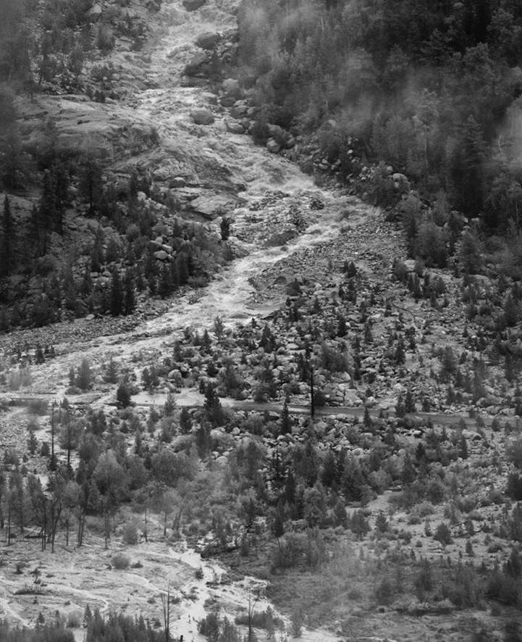
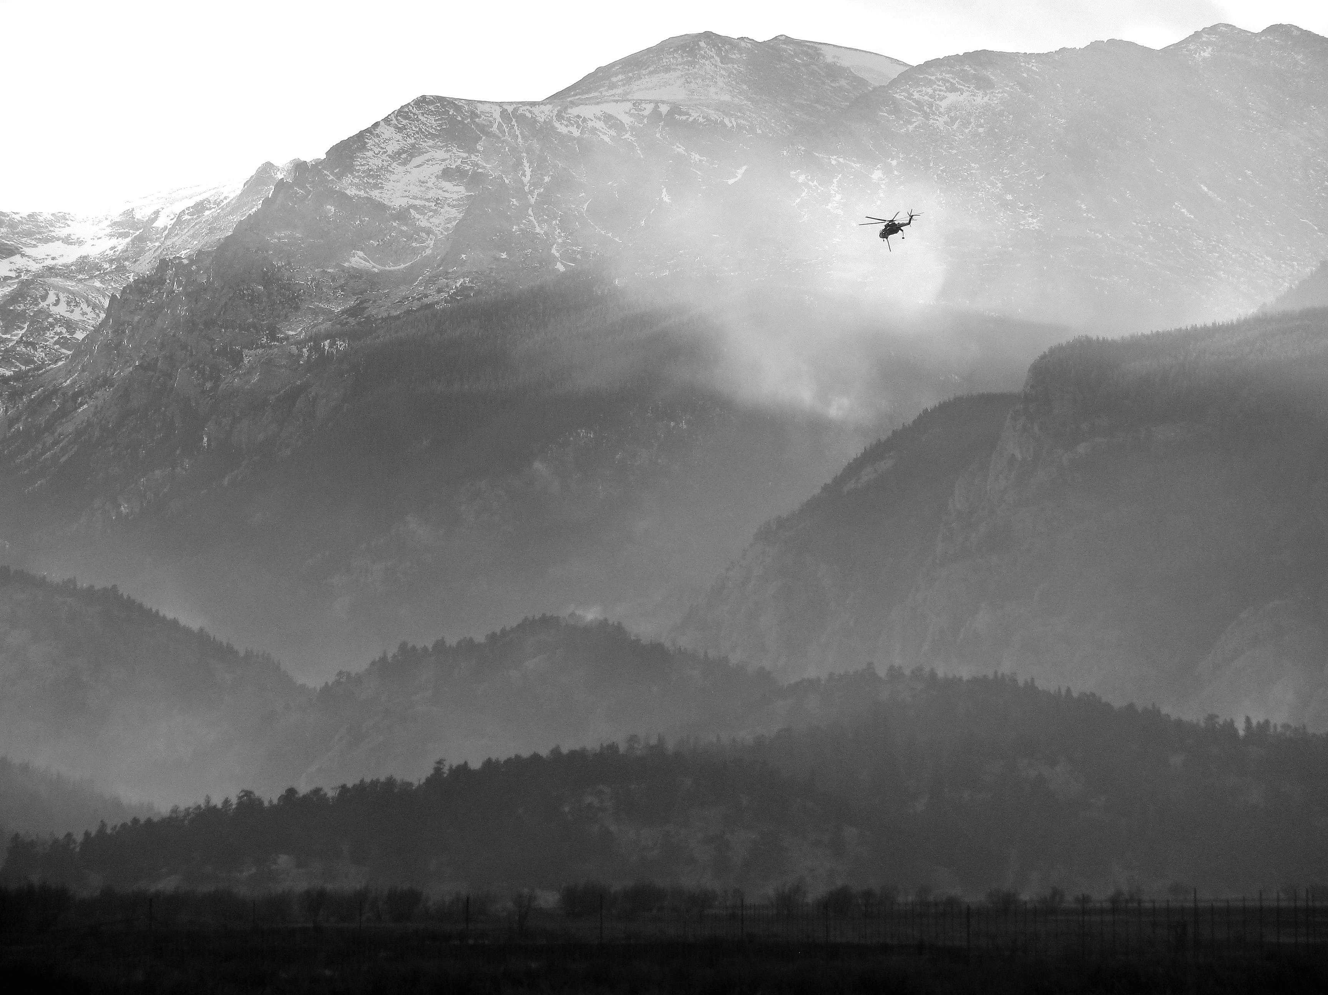
Ben Bobowski
RMNP
Bill Monahan
NPS I&M
Rocky Mountain PACE
2007: Climate Adaptation Workshop
2012: Severe Fern Lake winter fire following driest November in the 100 year
Issues
Snow/runoff
Fire
Landslides
Forest die-off
Cheatgrass
2013: Unpresented extreme ppt, flood, landsliding

Slide 20
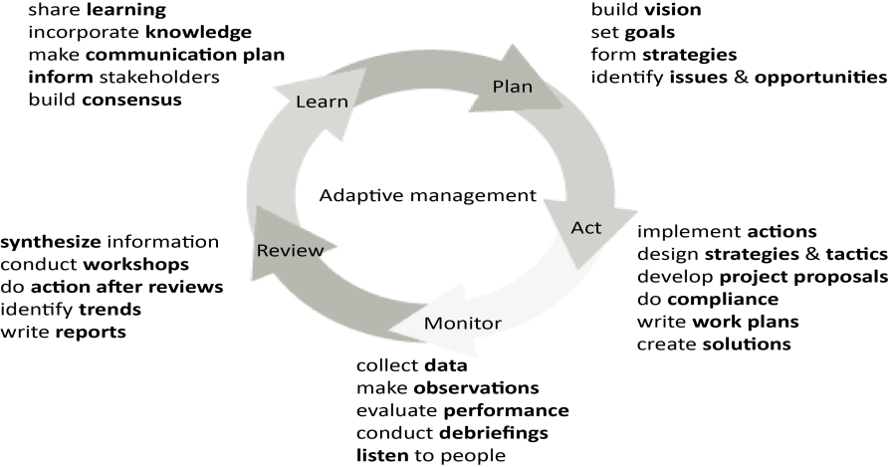
Ben Bobowski
RMNP
Bill Monahan
NPS I&M
Rocky Mountain PACE
RMNP Adaptive Management
“The time from the inception of science to the time it is applied can be decades.”
“…essential management activities: monitoring, research, education, and collaboration with partners.”
“What we find we need more of is the timely synthesis of existing science into working hypotheses to inform action.”
LCCVP
Delineate PACE
Climate 1900-2100
Ecosystem Processes
Limber Pine Climate Suitability
Watershed Assessment
Invasives
Communication
Ben Bobowski, Chief of Resources, Rocky Mountain National Park

Slide 21
Ben Bobowski
RMNP
Bill Monahan
NPS I&M
Rocky Mountain PACE
RMNP Adaptive Management
“The time from the inception of science to the time it is applied can be decades.”
“…essential management activities: monitoring, research, education, and collaboration with partners.”
“What we find we need more of is the timely synthesis of existing science into working hypotheses to inform action.”
LCCVP
Delineate PACE
Climate 1900-2100
Ecosystem Processes
Limber Pine Climate Suitability
Watershed Assessment
Communication
Ben Bobowski, Chief of Resources, Rocky Mountain National Park

Slide 22
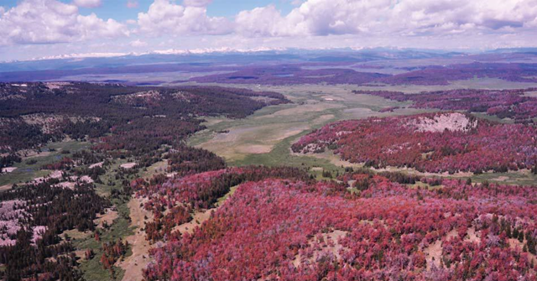
Kristen Legg
GRYN I&M
Greater Yellowstone
Whitebark Pine
Keystone species, early responder to climate change, candidate T&E species

Slide 23
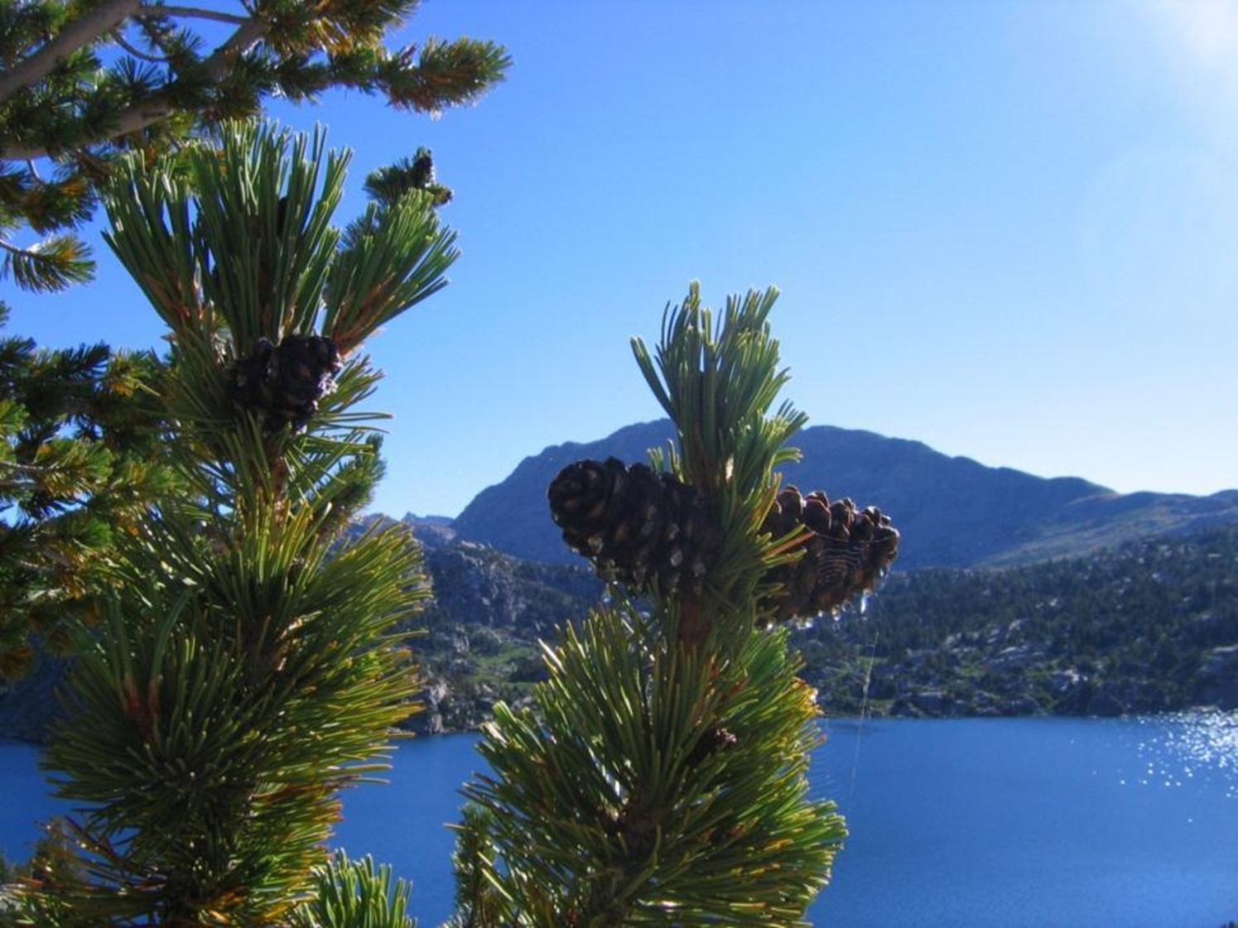
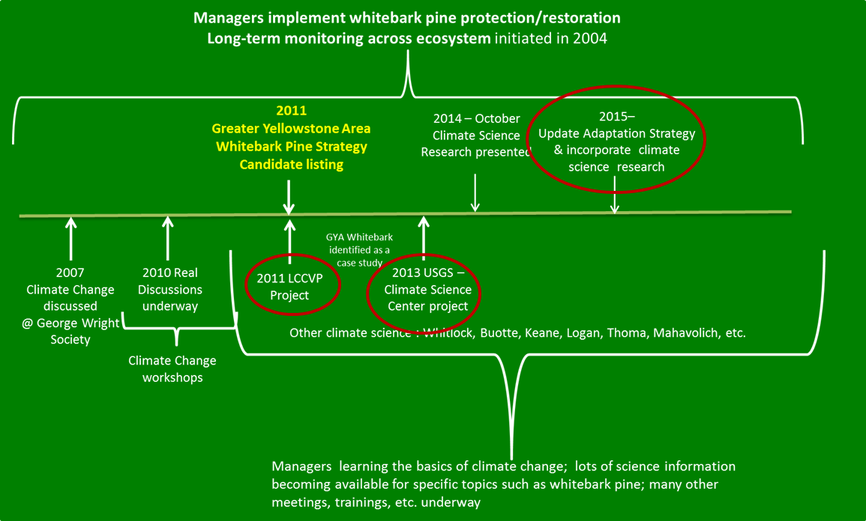
Kristen Legg
GRYN I&M
Greater Yellowstone
Adaptation Development & Evaluation:
Greater Yellowstone Whitebark Pine Adaptation Plan
Whitebark Pine Subcommittee – Greater Yellowstone Coordinating Committee

Slide 24
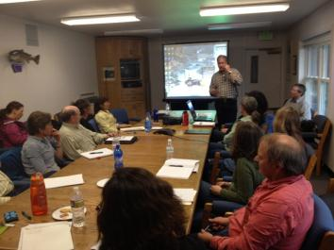
Kristen Legg
GRYN I&M
Greater Yellowstone
Questions Addressed by LCCVP
Where should treatments be placed in the landscape?
How effective would the climate informed treatments be under current land allocation constraints?
What spatial distribution of treatments is necessary to maintain functioning WBP under climate change?

Slide 25
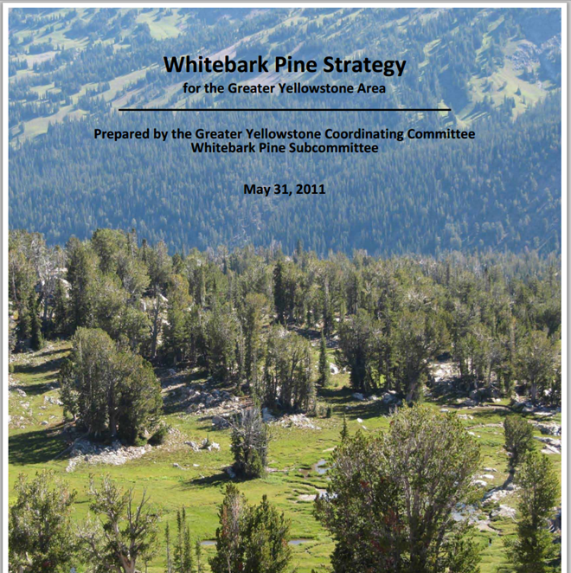
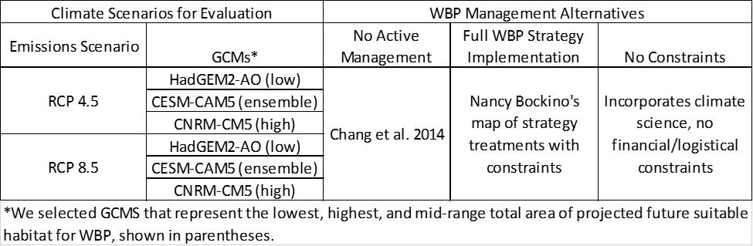
Greater Yellowstone
Management Alternatives under Climate Change

Slide 26
Greater Yellowstone
Organize management by climate suitability zone
RCP 4.5
Core habitat
Deteriorating habitat
Future habitat
RCP 8.5
Core Habitat. Manage to retain the species in these vitally important zones.
Future habitat. Manage for natural colonization and assisted colonization.
Deteriorating Habitat. Manage to sustain ecosystem function as long as possible.

Slide 27
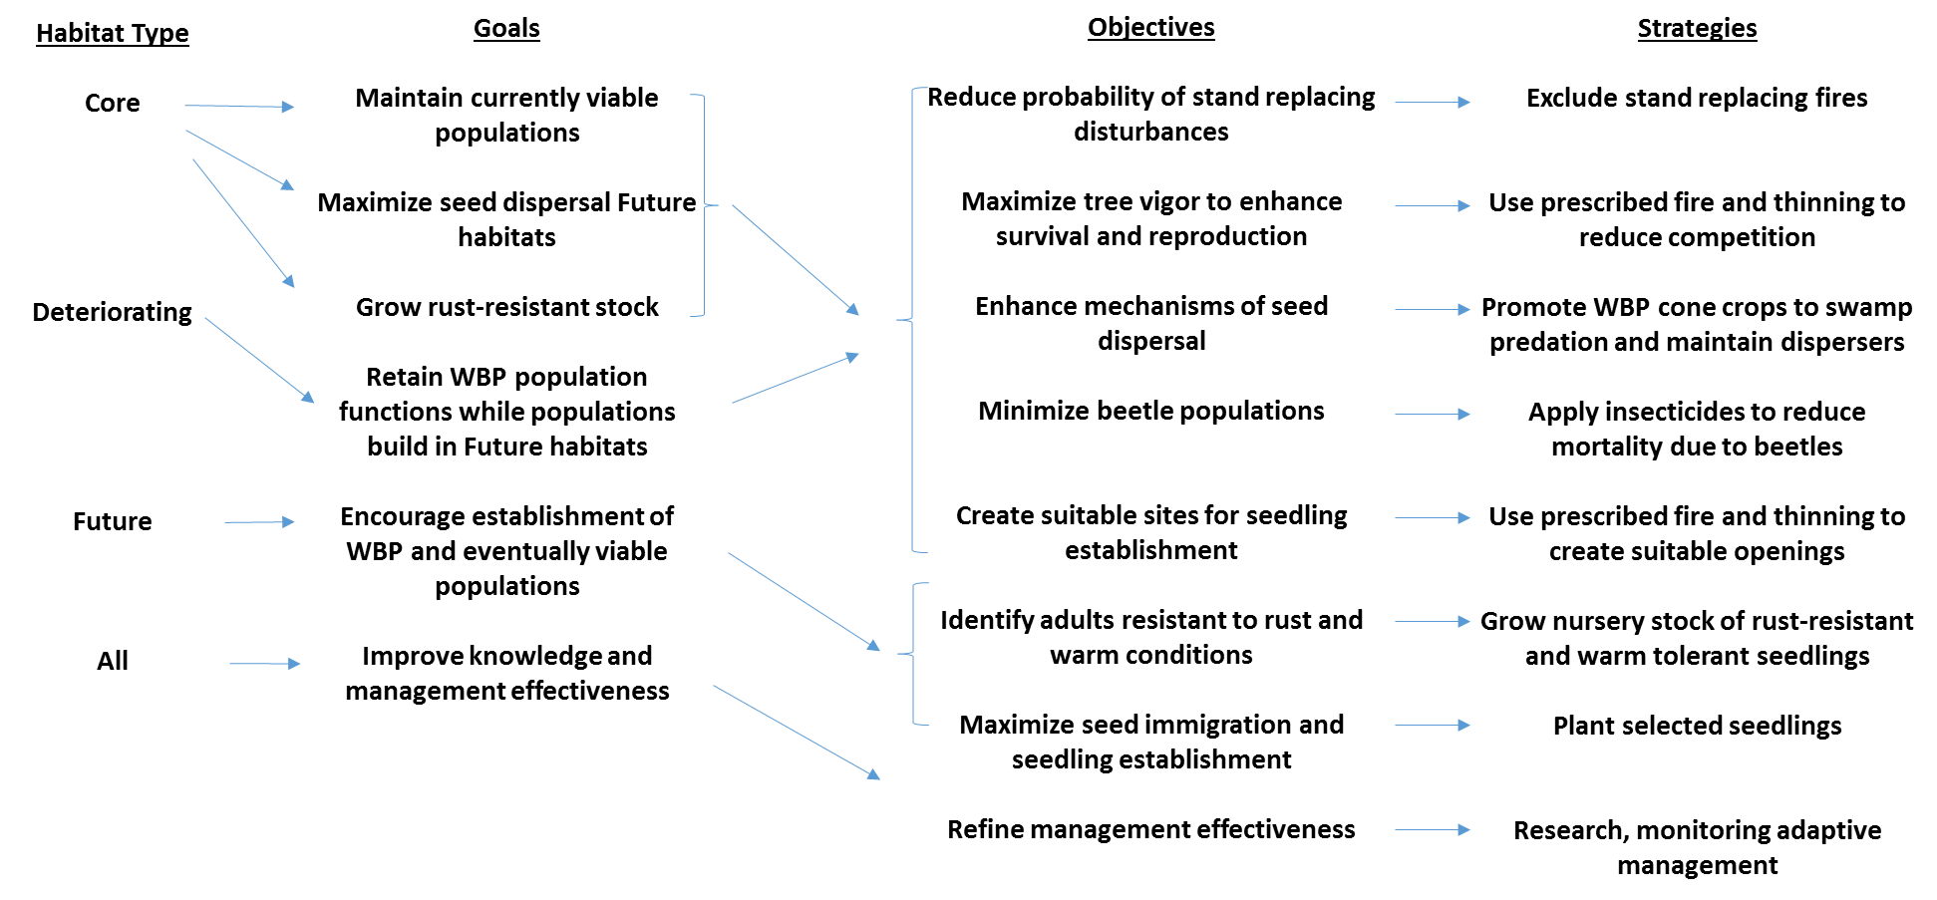
Greater Yellowstone
Organize management by climate suitability zone

Slide 28
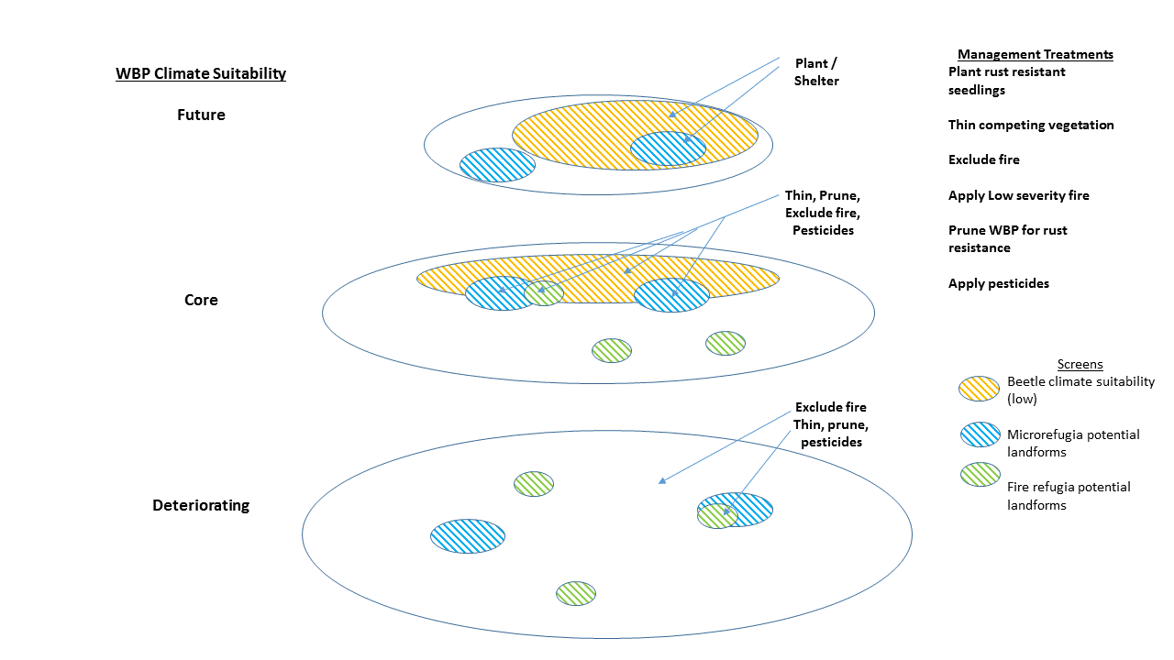
Greater Yellowstone
Using Climate Science to Place Treatments in the Landscape

Slide 29
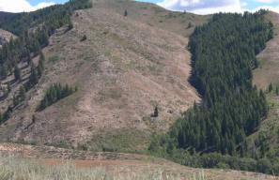
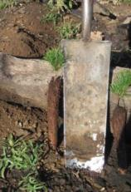
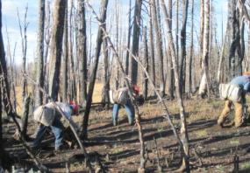
Planting Site Assessment Checklist
I. Landscape-Level Variables:
Climate projection models
Bio-refugia/habitat suitability identified by field or modeling data using biological & abiotic variables
II. Site Specific Variables:
Edaphic characteristics: slope, aspect, soil type, elevation
Climate variables at the site level
Available microsites – type, quantity, quality
On burned sites, time since fire
Overstory rust infection rate or potential (low-medium-high)
Competing species – density, presence/absence
Suitability of site for competitor
Follow USFS seed planting guidelines
III. Planting effectiveness monitoring framework
Develop and implement sampling and analysis plan for long-term effectiveness monitoring of planting sites.
Monitor natural regeneration within planting sites & compare to natural regeneration in non-planted sites.
Site characteristics & climate
Photo: Thane Tuason

Slide 30


Social Science Evaluation of WBP Management
Elizabeth Shanahan, Helen Naughton, Eric Reilly
Social Values Regarding WBP and Management
Tri-state survey to understand attitudes of residents in the Northern Rockies toward WBP and WBP management strategies across varying land designations.
Dependent variables
-willingness to pay
-management strategies (protection, restoration, no management)
-assessment of extent of the threat to WBP
-valuation of WBP ecosystem services
Independent variables
-knowledge and experience
-environmental attitudes (NEP scale)
-attitudes toward governance and taxation
-trust of information sources
-demographics
Multimodal distribution of survey: Qualtrics for web-based survey and snail mail survey
Sample: representative sample in each state (MT, WY, ID) based on residential addresses
Responses will be geo-coded to reveal variation in attitudes by distance-from WBP and federal public lands

Slide 31


Adaptation Options: Whitebark Pine
Paleo Analysis
Iglesias et al. 2015. Plos ONE
Mechanistic Modeling
Ben Poulter
Katie Ireland
Kristen Emmett
Keane et al. 2010. Ecol. Modeling.

Slide 32


Scaling from Resources to Ecosystems
How well are we sustaining ecosystems and the services they provide to human societies?

Slide 33
Sustaining Greater Yellowstone
GYE Ecological Integrity Report Card
Vital Sign | Public Lands |  | Private Lands |  | All Lands
 | Grade | Certainty | Grade | Certainty | Grade
Snowpack and river discharge | C | High | D | High | C
Air quality | A | High | B | High | B
Hydrologic Integrity and water quality | A | High | D | Low | C
Forest Mortality | C | High | B | High | C
Wildfire deviation from natural range | A | Medium | C | Medium | B
Habitat fragmentation | A | High | C | High | B
Large Mammals | A | High | A | High | A
Breeding Birds | A | Medium | C | Medium | B
Fish and amphibians | C | Medium | E | Medium | D
Connectivity to other wildlands | B | Medium | B | Medium | B

Slide 34

Planetary Boundary Approach
-aims to define a safe operating space for human societies to develop and thrive, based on our understanding of the functioning and resilience of the Earth system.
Steffen et al. 2015. Science

Slide 35

Sustainable Ecosystem Boundaries: GYE
Hansen et al. In Prep.

Slide 36
Future Directions
Define a safe operating space for human societies within local to regional ecosystems
Assess what people value in ecosystems
Identify relevant metrics
Establish safe operating zones for metrics
Monitor and evaluate status and trends
Communicate to stakeholders and decision makers
Feedbacks to adaptation options

Slide 37

Acknowledgements
NASA Applied Sciences Program (Grant 10-BIOCLIM10-0034)
NSF EPSCoR Track-I EPS-1101342 (INSTEP 3)
NASA Land Cover Land Use Change Program
North Central Climate Sciences Center
Federal agency collaborators

Slide 38
Evolution of Climate Adaptation
NASA CCBR
Western Governors Assoc.
Connectivity
NWF Adaptation Framework
Scanning the Conservation Horizon Climate Smart
Climate Science Centers
NC-CSC
Sci/mgt RAM Funded projects Symposium
DOI Sec Order 3829
LCCVP
Partners Vuln Assmnts Partnerships Adaptation Options
Landscape
Conservation
Cooperatives
Framework Partnerships Funded Projects Webinars Data Base
UN Convention on Biodiversity / IUCN
Achi Accords LZS Symp Climate Adaptation World Pks Congr Adaptation Guide
NPS
Revisiting Leopold Climate Response Program Implementing Leopold
2010 2011 2012 2013 2014 2015

Slide 39
Evolution of Climate Adaptation
NASA CCRB
Western Governors Assoc.
Theobald
Connectivity
NWF Adaptation Framework
Gross
Scanning the Conservation Horizon Climate Smart
Hansen, Gross, Monahan, Theobald
Climate Science Centers
NC-CSC
Sci/mgt RAM Funded projects Symposium
Hansen, Gross, Monahan, Theobald, Goetz, Melton
DOI Sec Order 3829
LCCVP
Partners Vuln Assmnts Partnerships Adaptation Options
LCCVP
Landscape
Conservation
Cooperatives
Hansen, Monahan, Theobald, Goetz, Melton
Framework Partnerships Funded Projects Webinars Data Base
Gross, Hansen
UN Convention on Biodiversity / IUCN
Achi Accords LZS Symp Climate Adaptation World Pks Congr Adaptation Guide
Gross, Olliff, Monahan
Olliff
NPS
Revisiting Leopold Climate Response Program Implementing Leopold
2010 2011 2012 2013 2014 2015

Slide 40

Fourth Year Activities
Book with Island Press
Final Collaborator Workshops
  GYE: April 2015
  ROMO: Oct 2015
  APLCC: Nov 2015
Decision Support Delivery
  GNLCC
  NCCSC
  National Parks and National Forests
Peer Review Publications
NASA workshop on international applications
YNP Photo Archives

Slide 41
Climate Vulnerability and Adaptation Planning across Ecosystems: Collaborative Approach
Protected Area Centered Ecosystems
Rocky Mountain
Greater Yellowstone
Great Smoky Mountain, SHEN, DEWA
John Gross, NPS Climate Scientist
Ben Bobowski, Chief of Resources, Rocky Mountain National Park

Slide 42

DOI Climate Adaptation
Secretarial order 3289 (2010)
“apply scientific tools to increase understanding of climate change and to coordinate an effective response to its impacts”.
Climate Science Centers
Landscape Conservation Cooperatives
2010 – 2015 a period of rapid evolution and progress.
Notes:
42

Slide 43
Topics
Scientific Framework
Vulnerability Assessment
  Climate Change
  Coarse Filter biodiversity
  Vegetation
Links to Management
  Rocky Mountain National Park
  Greater Yellowstone
Sustaining Wildlands
Notes:
43

Slide 44

Management Challenges
The concepts and language of climate change are unfamiliar.
The science of climate change is new and highly uncertain.
High uncertainty and long time frames cloud decision making.
Occurs at much larger spatial scales than management units.
Adaptation frameworks poorly understood
Climate change is considered critical but not urgent.
Climate change involves social complexity with fragmented stakeholders
Dan Wink, YNP Superintendent
Notes:
44

Slide 45


LCCVP Decision Support

